Slide 1
America’s History
Chapter 27
Civil Rights Movement

Slide 2
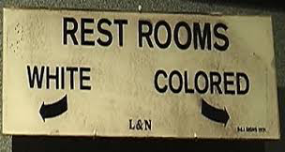
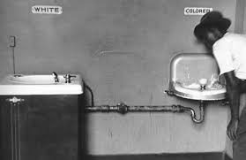
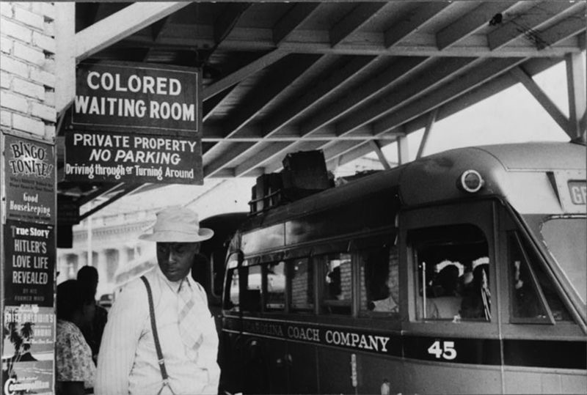
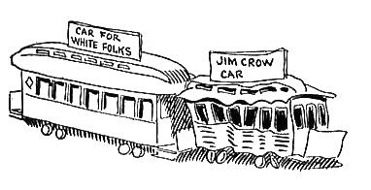
The Emerging Civil Rights Struggle, 1941 - 1957
Rights Liberalism: belief that the government must protect people from discrimination
Life Under Jim Crow
  Jim Crow laws were prevalent in the South
  Poll taxes, literacy tests, and “white primaries” discouraged African Americans from voting
  Housing in the North was heavily segregated
    Violence used to discourage blacks from living in white neighborhoods

Slide 3
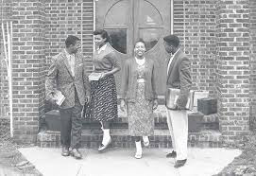

The Emerging Civil Rights Struggle, 1941 - 1957
Origins of the Civil Rights Movement
  Nazi racism was attacked during WWII
  The Cold War aided the Civil Rights Movement
    US claimed democracy was better than communism
  African American college students played a large role in the movement in the 1960s
  TV showed demonstrations and violence against blacks

Slide 4
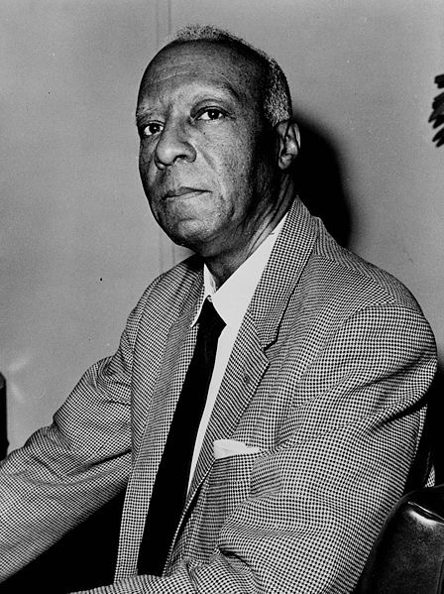
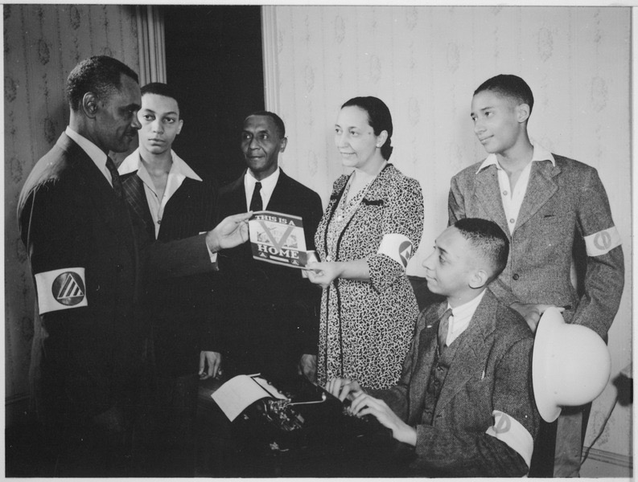
The Emerging Civil Rights Struggle, 1941 - 1957
World War II: The Beginnings
  Executive Order 8802:
    A. Philip Randolph proposed a March on Washington
    FDR barred discrimination in defense industries
  The Double V Campaign:
    Victory over fascism and victory over racism at home
    James Farmer - founding member of the Congress of Racial Equality (CORE)
      Play an instrumental role in the 1960s
    Many African American veterans benefitted from the GI Bill

Slide 5
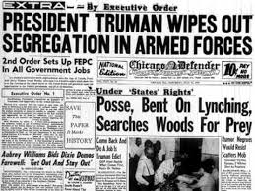
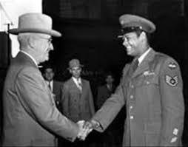
The Emerging Civil Rights Struggle, 1941 - 1957
Cold War Civil Rights
  Civil Rights and the New Deal Coalition:
    “To Secure These Rights” government report under Truman’s administration that advocated government involvement to ensure equality for blacks
    Executive Order # 9981 - desegregated US military
      Korean War was the first war fought with desegregated units
    States’ Rights Democratic Party (Dixiecrats)
      Southern Democrats led by Strom Thurmond, who ran for president in 1948
  Race and Anticommunism:
    Racism in the US aided the Soviet Union in the Cold War

Slide 6
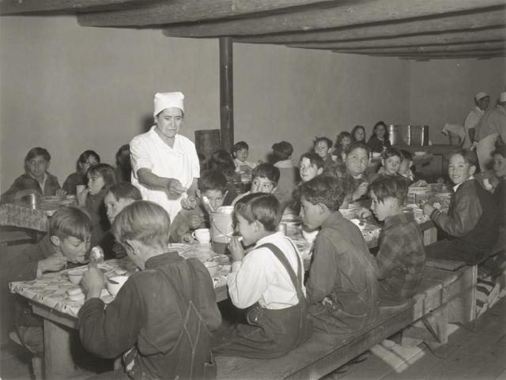
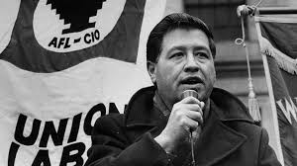
The Emerging Civil Rights Struggle, 1941 - 1957
Mexican Americans and Japanese Americans
    Mexican Americans faced similar discrimination - poll taxes and poor, rundown neighborhoods
    Cesar Chavez - United Farm Workers (UFW)
    Mendez v. Westminster (1947):
      Segregated Mexican schools were not allowed
    California’s Alien Land Law was overturned
      Forbade Japanese immigrants from owning land

Slide 7
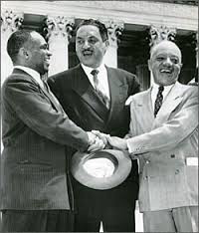
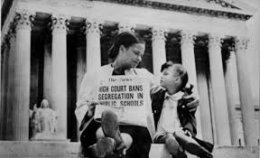
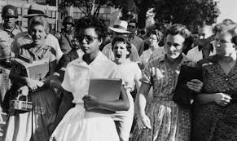
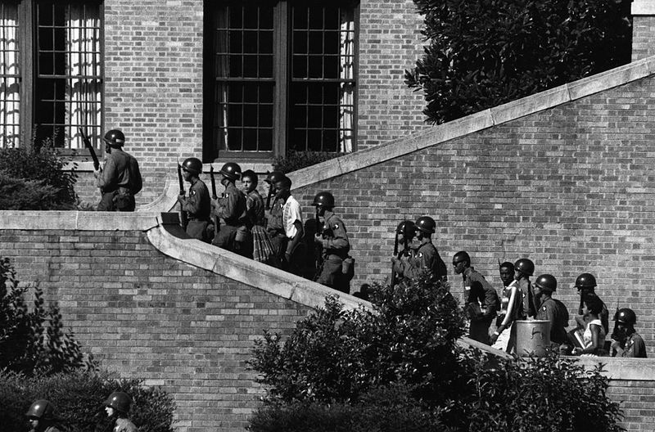
The Emerging Civil Rights Struggle, 1941 - 1957
Fighting For Equality Before the Law
    Thurgood Marshall
      NAACP lawyer, future justice of the Supreme Court
      Smith v. Allwright (1944) - white primaries were unconstitutional
      Lead attorney in Brown v. Board
    ***Brown v. Board of Education***:
      Overturned “separate but equal” established by Plessy
      Led to resistance by Southerners:
        Massive Resistance - schools would shut down, rather than desegregate
        The Southern Manifesto - Southern Congressmen argued the Supreme Court overstepped its power
      Little Rock Nine:
        Eisenhower used troops to protect 9 black students at Little Rock High School

Slide 8
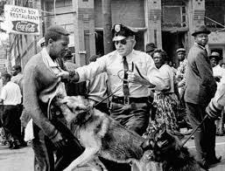
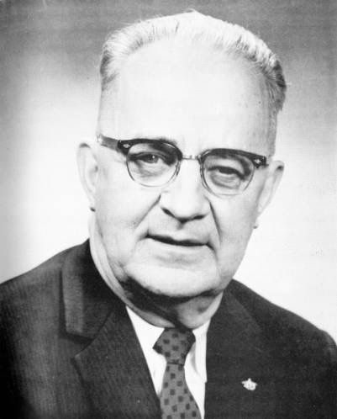
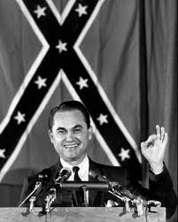
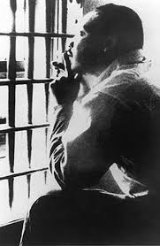
Forging a Protest Movement, 1955 - 1965
Legislating Civil Rights, 1963 - 1965
  The Battle for Birmingham:
    Eugene “Call me Bull” Connor - ordered the police to use force against protestors
      Images appeared in newspapers and tv
    Letter from a Birmingham Jail
      MLK justified his approach - inspired by Gandhi and Jesus
    George Wallace tried to prevent black students from the University of Alabama

Slide 9
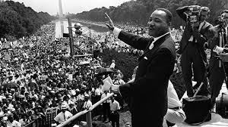
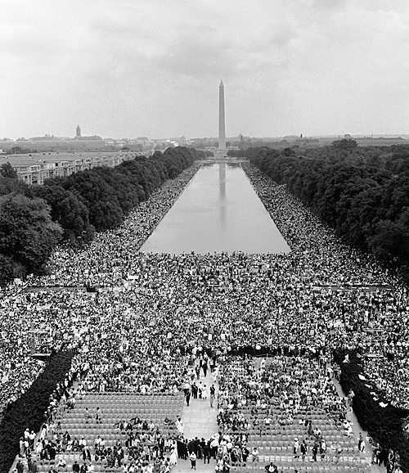
Forging a Protest Movement, 1955 - 1965
  The March on Washington and the Civil Rights Act:
    August, 1963 - King, one of many speakers, delivered his famous “I Have a Dream” speech
      250,000 in attendance
    ***Civil Rights Act of 1964 - Specifically mentioned in the new curriculum***
      Outlawed discrimination based on race, sex, origin, and religion
      Government could cut off funding where discrimination occurred

Slide 10
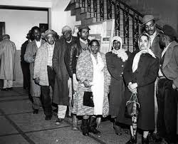
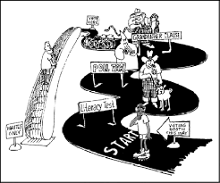
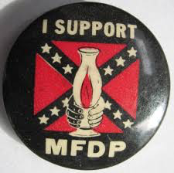
Forging a Protest Movement, 1955 - 1965
Legislating Civil Rights, 1963 - 1965
  Freedom Summer
    SNCC, CORE, NAACP, and SCLC helped register voters in 1964
    Mississippi Freedom Democratic Party - sought to attend the Democratic National Convention in Atlantic City
      The convention did not recognize the party and they were left out

Slide 11
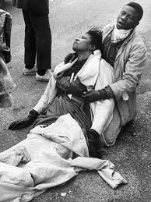
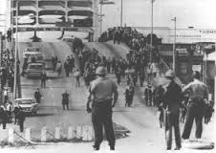
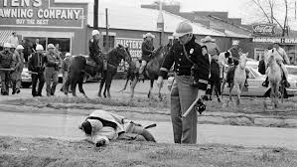
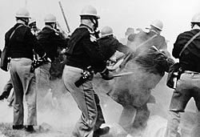
Forging a Protest Movement, 1955 - 1965
  Selma and the Voting Rights Act
    “Bloody Sunday” - attack of marchers from Selma to Montgomery by state troopers
    Voting Rights Act of 1965:
      Barred literacy tests
      Federal government could register voters
    24th Amendment - barred poll taxes
    Many Southern whites switched from the Democratic Party to the Republican Party

Slide 12
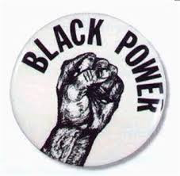
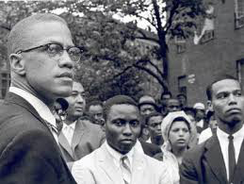
Beyond Civil Rights, 1966 - 1973
Black Nationalism
  Many meanings - pride, separatism, supporting black businesses, etc.
  Nation of Islam
    Popular among African Americans in cities

Slide 13
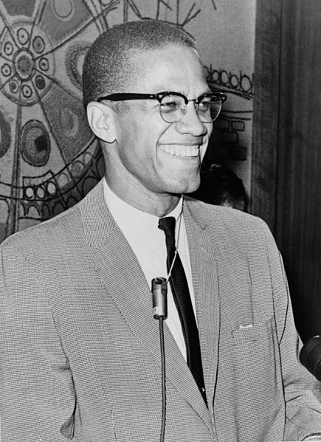
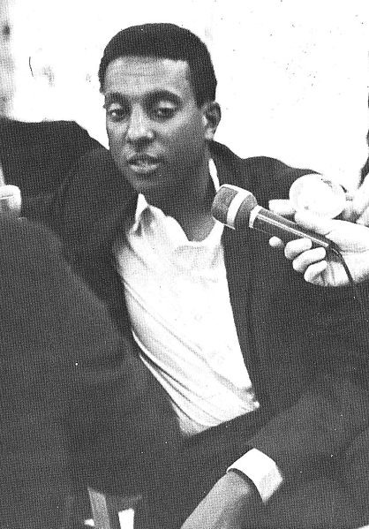

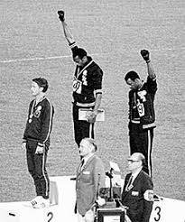
Beyond Civil Rights, 1966 - 1973
  Malcolm X
    Urged violence for self-defense
    Eventually he split from the NOI, and was murdered on February 21, 1965
  Black Power
    Stokely Carmichael - became leader of SNCC, advocated Black Power
      Focused on black pride and strengthening black communities

Slide 14
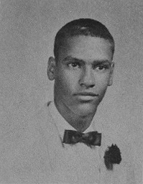
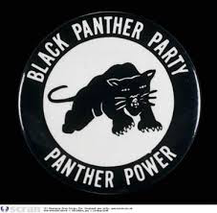
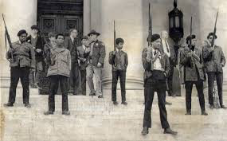
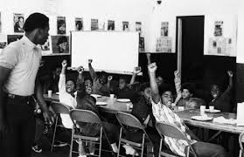
Beyond Civil Rights, 1966 - 1973
Black Nationalism
  Black Panther Party
    Founded in 1966 by Bobby Seale and Huey Newton
    Urged arming African Americans in pursuit of self-defense
    Popular in urban areas
      Focused on community programs - free breakfast for children

Slide 15
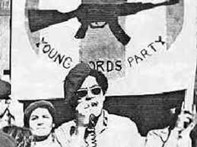
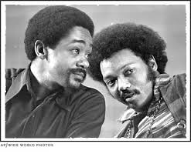
Beyond Civil Rights, 1966 - 1973
  Young Lords
    Inspired by Black Panthers
    Hoped for self-determination for Puerto Ricans in the US and the country
    Sought to improve conditions in neighborhood cities, particularly East Harlem
  The New Urban Politics
    Gary, Indiana and Cleveland, Ohio elected black mayors
    National Black Political Convention:
      Toyed with the idea of creating a third party, eventually continued to support the Democrats
      Sought national health insurance and elimination of the death penalty

Slide 16
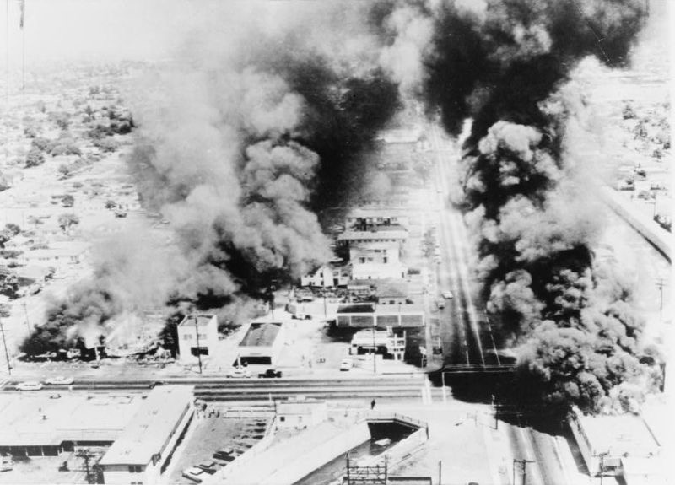
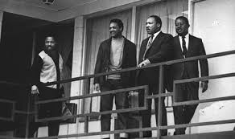
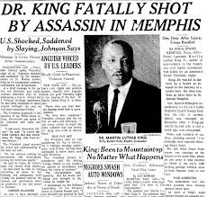
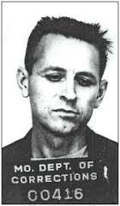
Beyond Civil Rights, 1966 - 1973
Poverty and Urban Violence
  Watts Riots of 1965:
    Weeklong riot in which 34 people were killed
  After more riots in 1967, the Kerner Commission investigated origins of violence
    “Our nation is moving toward two societies, one black, one white - separate and unequal.”
    MLK spoke out against the war in Vietnam - LBJ focused on the war more than poverty and issues at home
    On April 4, 1968, MLK was assassinated by James Earl Ray

Slide 17
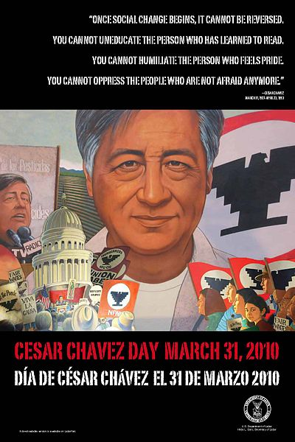
Beyond Civil Rights, 1966 - 1973
Rise of the Chicano Movement
  Cesar Chavez - helped create the United Farm Workers (UFW)
    Led a grape pickers’ strike to bring attention to the plight of Mexican-American workers
    1968 - 28 day hunger strike, met with Presidential Candidate and Attorney General, RFK

Slide 18
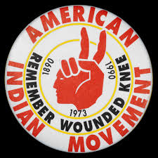
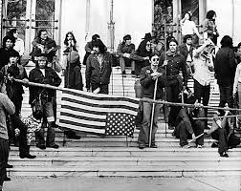
Beyond Civil Rights, 1966 - 1973
The American Indian Movement
  Faced the most challenges of any minority group:
    Stunningly high unemployment, poor housing and schools
  Indians of All Tribes (IAT) and American Indian Movement (AIM):
    Used protests to bring attention to their plight
    1969 - IAT took over Alcatraz Island
  Trail of Broken Treaties - protest across the country by many Native American groups
  Media attention was widespread of various Native takeovers

Slide 19
The Recap
Role of tv and the Cold War in the Civil Rights Movement
Executive Order 8802 - FDR - desegregated defense industries
Double V Campaign
Executive Order 9981 - desegregated the military
Dixiecrats
Thurgood Marshall
Brown v. Board
Civil Rights Act of 1964
Voting Rights Act of 1965
24th Amendment
March on Washington
Black Power, Malcolm X, and the Black Panthers
Kerner Commission
Chicano Movement and Native Americans

